Slide 1


Medium-Range Excessive Rainfall Prediction with Machine Learning
Dr. Aaron J. Hill^{1,2} and Dr. Russ S. Schumacher³
¹School of Meteorology, University of Oklahoma
²NSF AI Institute for Research on Trustworthy AI in Weather, Climate, and Coastal Oceanography (AI2ES)
³Department of Atmospheric Science, Colorado State University
EGU General Assembly, AS 1.1 15 April 2024
Research supported by NOAA JTTI grant NA21OAR4590187​
​

Slide 2
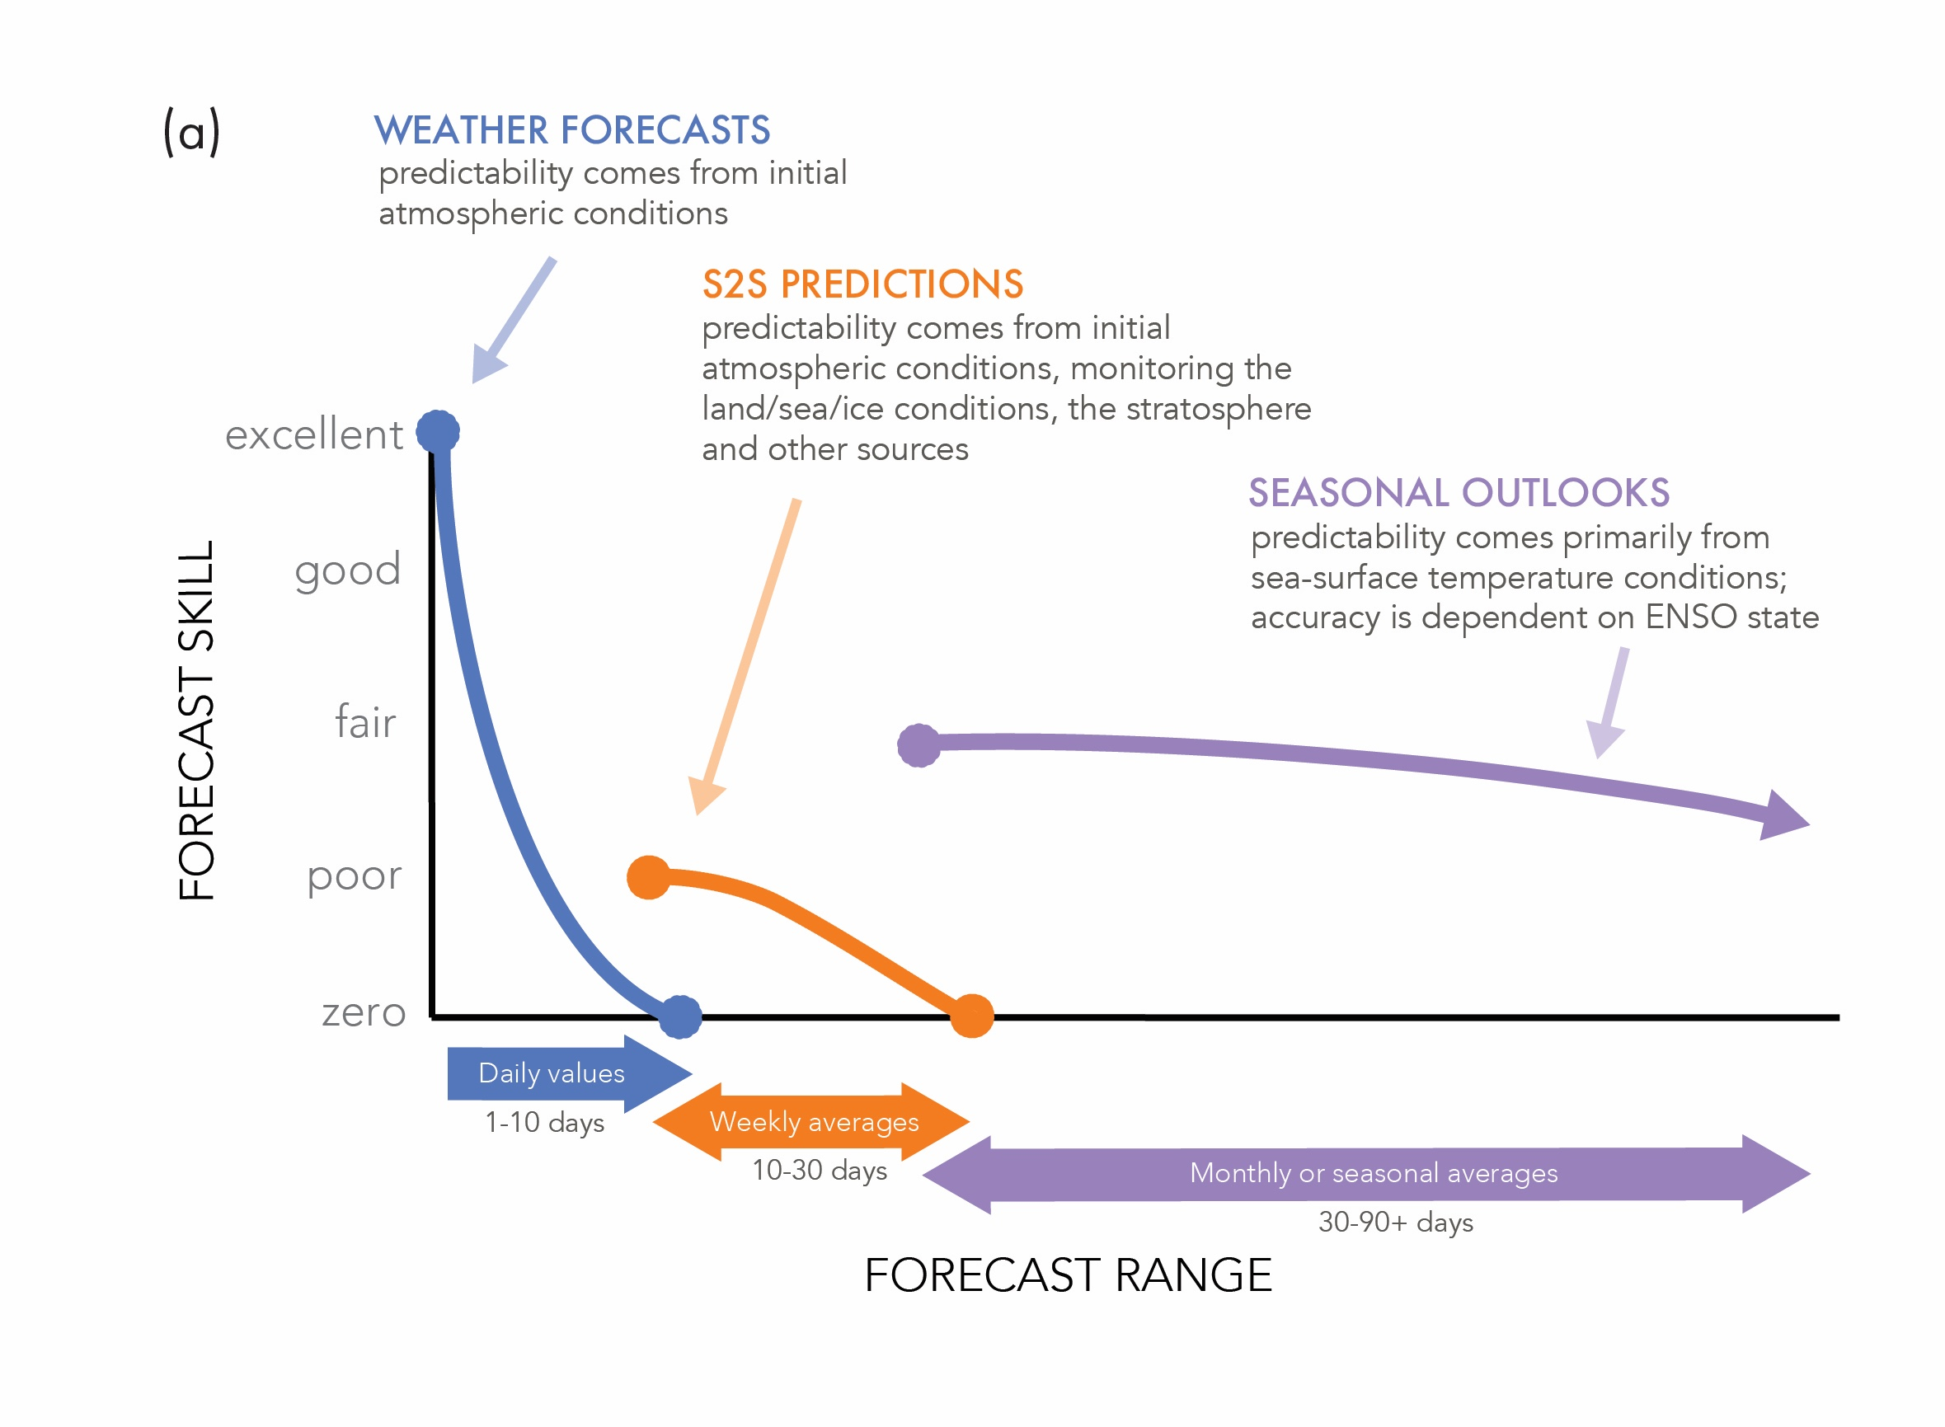
Predictability scales with time AND hazard
White et al. (2017), https://doi.org/10.1002/met.1654

Slide 3
Predictability scales with time AND hazard
Hazard-specific skill
may be much worse!
White et al. (2017), https://doi.org/10.1002/met.1654

Slide 4
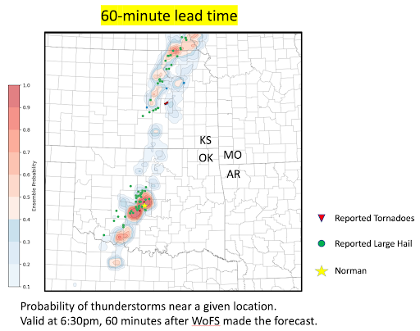
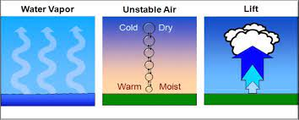
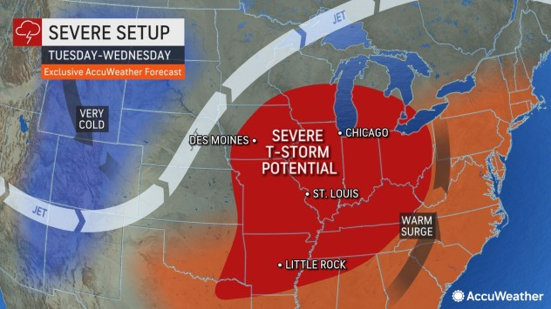
Current approaches for medium-range predictions of high-impact hazards
Ingredients-based forecasting at synoptic scales
for day(s) ahead prediction (Johns and Doswell 1992; Doswell et al. 1996)
Convection-allowing models;
Logistical/predictability limits > 3 days
Sources: https://inside.nssl.noaa.gov/nsslnews/wp-content/uploads/sites/21/2023/06/unnamed.png, https://www.weather.gov/media/zhu/ZHU_Training_Page/thunderstorm_stuff/Thunderstorms/thunderstorms.pdf, https://cms.accuweather.com/wp-content/uploads/2023/03/SevSetUpTuesWedChan31Mar11a.jpg?w=632

Slide 5
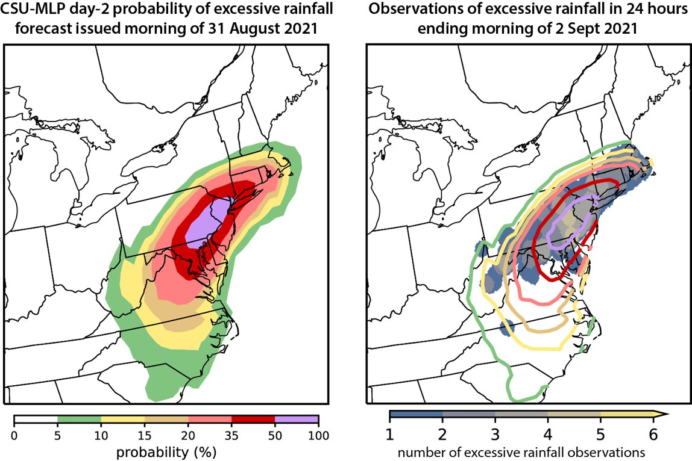
ML can extend (and improve) the prediction
Convection-allowing models still don’t offer the proper resolution to resolve weather hazards
Proxies for hazards (e.g., updraft helicity) are used to forecast hazard location and storm evolution – implicit prediction
Using historical observations of events, train machine learning (ML) models to predict events explicitly
Extend explicit predictions of high-impact
hazards into the medium-range with ML
The Conversation (2023): “AI and machine learning are improving weather forecasts, but they won’t replace human experts”

Slide 6
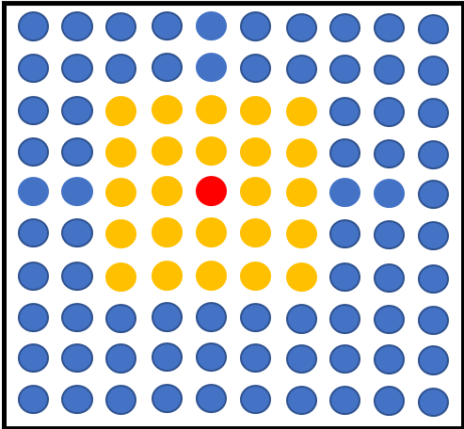
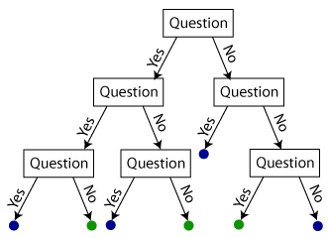
MLP Prediction System
Forecast point
Colorado State University Machine
Learning Probabilities (MLP)
(Herman and Schumacher 2018; Hill et
al. 2020; 2023; Schumacher et al. 2021)
Random Forests (RFs; Breiman 2001) trained on environments from the median of the Global Ensemble Forecast System (GEFS) and historical observations of excessive rainfall.
RFs: A series of questions that determine
environmental conditions favorable for hazards over a large sample
Forecasts constructed to mimic NCEP operational outlook products – “first-guess” forecasts, 24-hour probabilistic predictions of a hazard
T > 20 C?
…..
CAPE > 500 J/kg?
Probability of Rainfall
50%

Slide 7
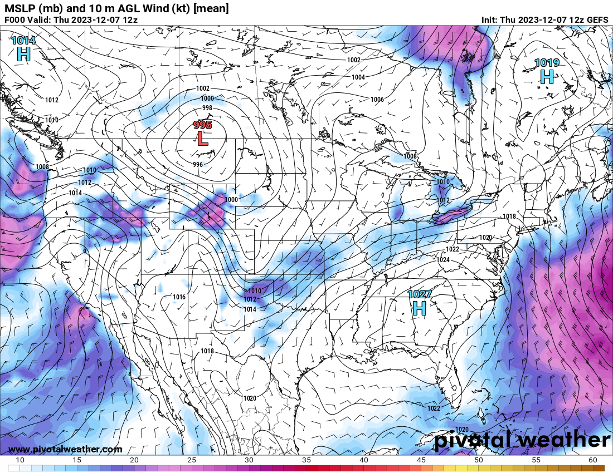
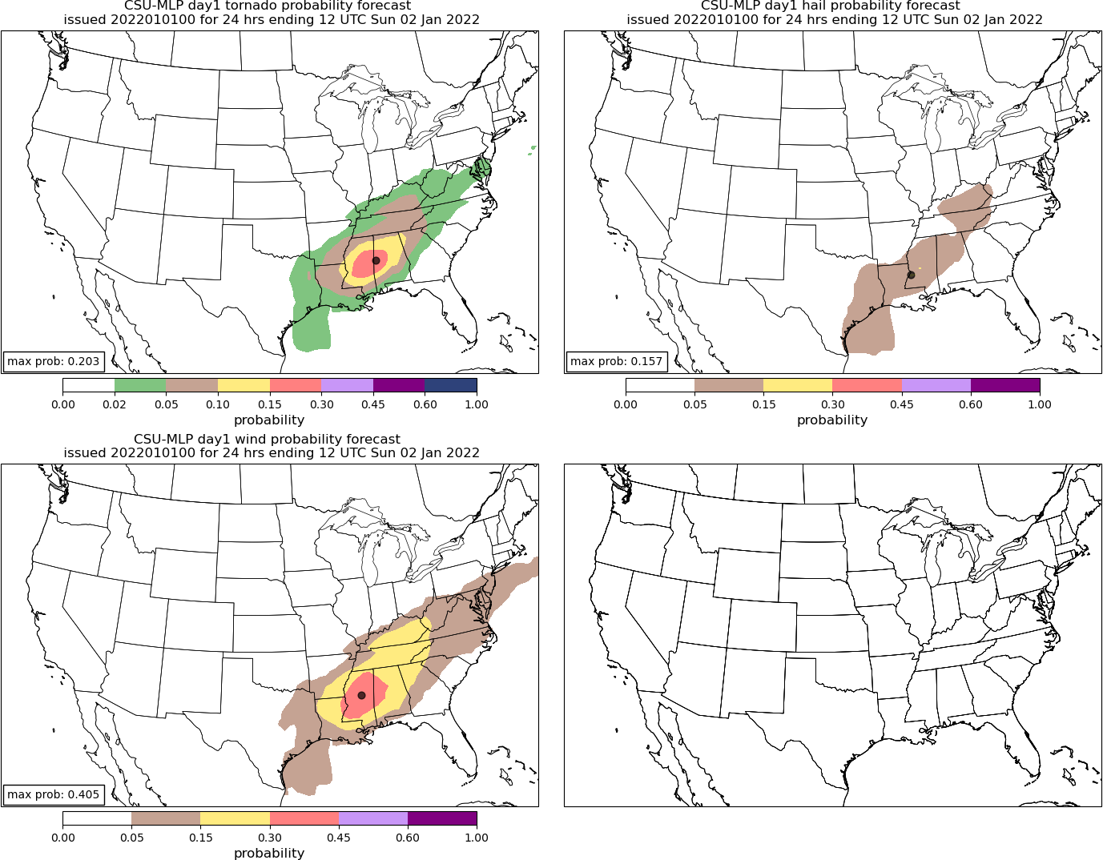
MLP Prediction System
Historical Daily Events Defining
Training Sample (10 years)
24 h forecast window
GEFS ensemble median of
environmental parameters
QPF
CAPE
CIN
MSLP
Shear
etc.
Real-time Predictions
MODEL
Real-time GEFS
predictors

Slide 8
Two excessive rainfall datasets
We want to predict excessive rainfall…but what is excessive rainfall?
Exceeding flash flood guidance? Produces a flash flood report? More than a certain threshold? (and if so, which one(s)?) What quantitative precipitation estimate to use?
1) Fixed Frequency – climatological average recurrence intervals (ARIs) to define a heavy or extreme rain event
- Better corresponds to actual impacts in a given region than a fixed threshold (e.g., 2 inches)
- Doesn’t bias the verification statistics toward climatologically wet regions
- Use the NCEP Climatology-Calibrated Precipitation Analysis (CCPA) to identify historical exceedances of average recurrence intervals (1 and 2 yr) for 24-hour rainfall accumulation
2) Unified Flood Verification System (UFVS; Erickson et al. 2019,2021)
- Flash flood reports, exceedances of FFG or the 5-yr ARI, and reports of flooding from USGS stream gauges

Slide 9
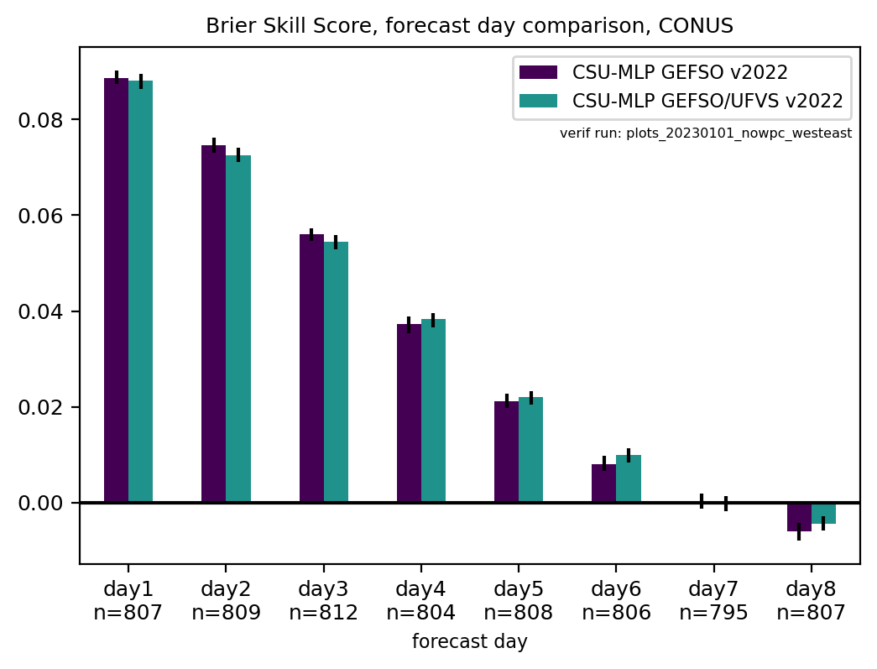
Skillful predictions out 6-7 days
Skill as compared to a baseline, temporally varying daily climatology
Both prediction systems extend prediction skill out to 6-7 days with nearly equal skill for both excessive rainfall datasets
Predictability in this ML framework also likely a function of hazard type – caveat: it is hard to define “excessive rainfall”! (Hill and Schumacher 2021, Hill et al. 2024, in prep).
Fixed Frequency
UFVS

Slide 10
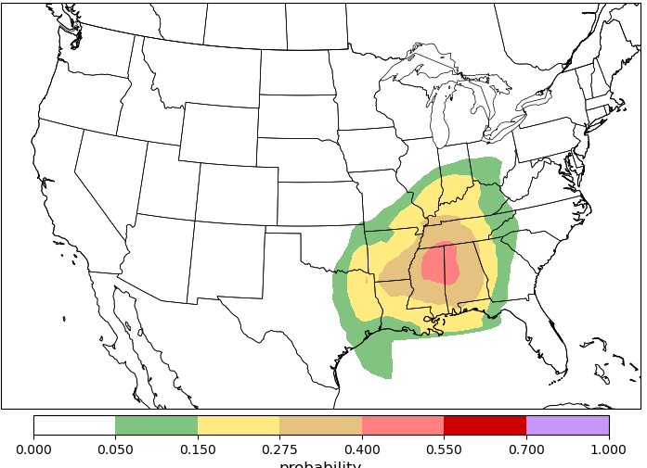
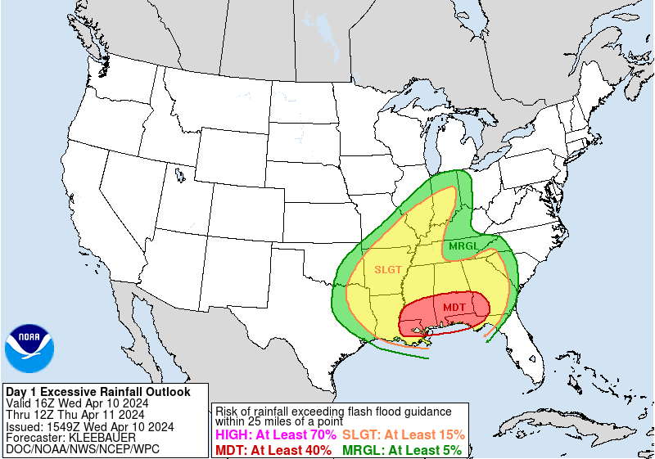
Shift from deterministic to ensemble framework
Probabilities map to categories → used deterministically!
Hill and Schumacher, 2024 (in prep)

Slide 11
Shift from deterministic to ensemble framework
Median prediction
GEFS initial spread
Hill and Schumacher, 2024 (in prep)

Slide 12
Shift from deterministic to ensemble framework
Median prediction
GEFS initial spread
GEFS-member prediction
Hill and Schumacher, 2024 (in prep)

Slide 13
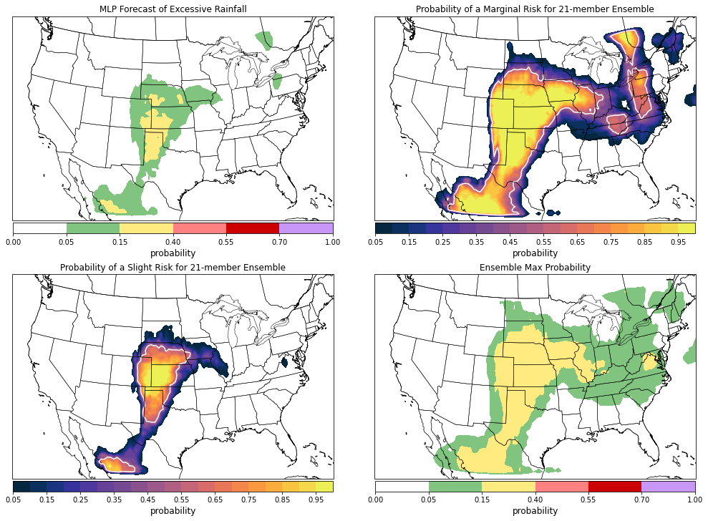
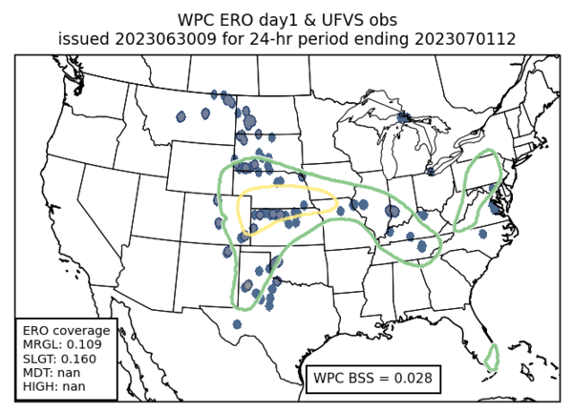
Shift from deterministic to ensemble framework
Day 1 MLP Excessive Rainfall Forecast
Valid 12 UTC 30 June 2023 – 12 UTC 1 July 2023
Probability of at least a “Marginal Risk” (5-15%)
21-member ensemble of MLP forecasts
Provides probabilistic information to operational forecaster end users who want to know about distribution of ML predictions
Further extends skill of hazard predictions? TBD
Weather Prediction Center ERO and corresponding observations for valid period
Probability of at least a “Slight Risk” (15-40%)
21-member ensemble of MLP forecasts
Ensemble max probability

Slide 14
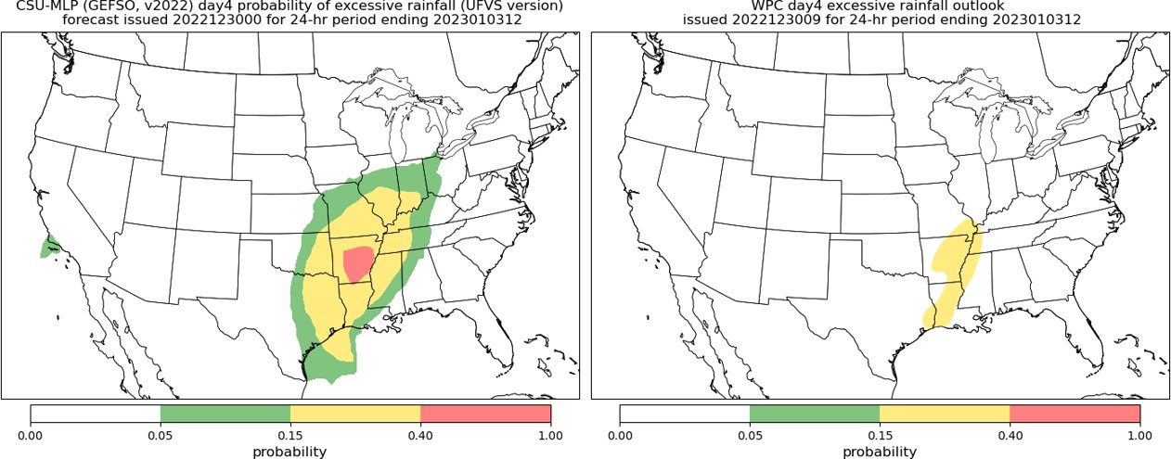

Summary and Discussion
ML prediction models are extending our predictability of convection hazards much further than current capabilities with NWP models, out 6-7 days
The future is in ensemble predictions, afforded by fast computers!
Outside of post-processing methodologies like the MLP, other pure data-driven approaches present ensembles (e.g., 1000 members) as the next step for AI models to capture representative uncertainty → can they do this for localized hazards?
One of the most important aspects of AI-based predictions is building trust with end-users (e.g., forecasters) – models and forecasts should be interpretable and explainable
MLP real-time forecast graphics:
https://schumacher.atmos.colostate.edu/hilla/csu_mlp
Contact with questions/comments: ahill@ou.edu

Slide 15
Coupling predictions, analysis, and interpretability to build trust

Slide 16
We can explain and interpret the ML models
10m-500hPa shear for day 2 hail forecasts
Despite not trained to do so, the RFs are capable of learning long-standing relationships between environmental parameters and severe weather occurrence – CAPE and wind shear important for hail production; diurnal patterns of instability
Interpreting and explaining the model forecasts builds trust with forecasters, especially when the models are using traditional ingredients that forecasters would use
day 2 tornado
CAPE for day 2 hail forecasts
Diurnal cycle
Mazurek et al., 2023: “Can
Ingredients-Based Forecasting be Learned? Disentangling a Random Forest's Severe Weather
Predictions” (in review)
More important

Slide 17
